Slide 1
Sears and K-Mart Pitch Research

Slide 2
Audience Similarities Between Sears and Select Major Competitors (JC Penny and Lowe’s)
The three companies have audiences with very similar brand and consumer tastes.
Lowe’s consumers trend a bit more toward coastal, newer shopping tastes – example IKEA and Panera.
Major media outlets, magazines and websites are also remarkably similar. Note: Walmart Today is very strong with these audiences. So is Teen Vogue, which may provide opportunities to build brand loyalty with younger audiences.
Basketball dominates the sports social graph of all three companies, suggesting NBA partnerships could bear fruit.

Slide 3
Major Companies Followed by Sears, J.C. Penney, and Lowe’s Online Audiences

Slide 4
Major Food/Beverage Brands Followed by Sears, J.C. Penney, and Lowe’s Online Audiences

Slide 5
Major Product or Services Followed by Sears, J.C. Penney, and Lowe’s Online Audiences

Slide 6
Major Non-Profits Followed by Sears, J.C. Penney, and Lowe’s Online Audiences

Slide 7
Major Media Outlets Followed by Sears, J.C. Penney, and Lowe’s Online Audiences

Slide 8
Major Websites Followed by Sears, J.C. Penney, and Lowe’s Online Audiences

Slide 9
Major Magazines Followed by Sears, J.C. Penney, and Lowe’s Online Audiences

Slide 10
Major Public Figures Followed by Sears, J.C. Penney, and Lowe’s Online Audiences

Slide 11
Major Athletes Followed by Sears, J.C. Penney, and Lowe’s Online Audiences

Slide 12
Insights into Sears and Kmart US Social Media Audiences
Word clouds of follower bio’s suggest heavy emphasis on family, positive affirmation, and fashion. They also help us identify pockets of potential micro-targeting - in this case like Christians, real estate pro’s, and animal lovers.
Unsurprisingly, women dominate the audience.
Competitors have much larger social media audiences, suggesting a strategy of micro-targeting segments of their social media communities with special deals.
Geographic distribution of social media engagers suggests strong southern strength. It follows that prioritizing southern media outlets may lead to effective press.

Slide 13
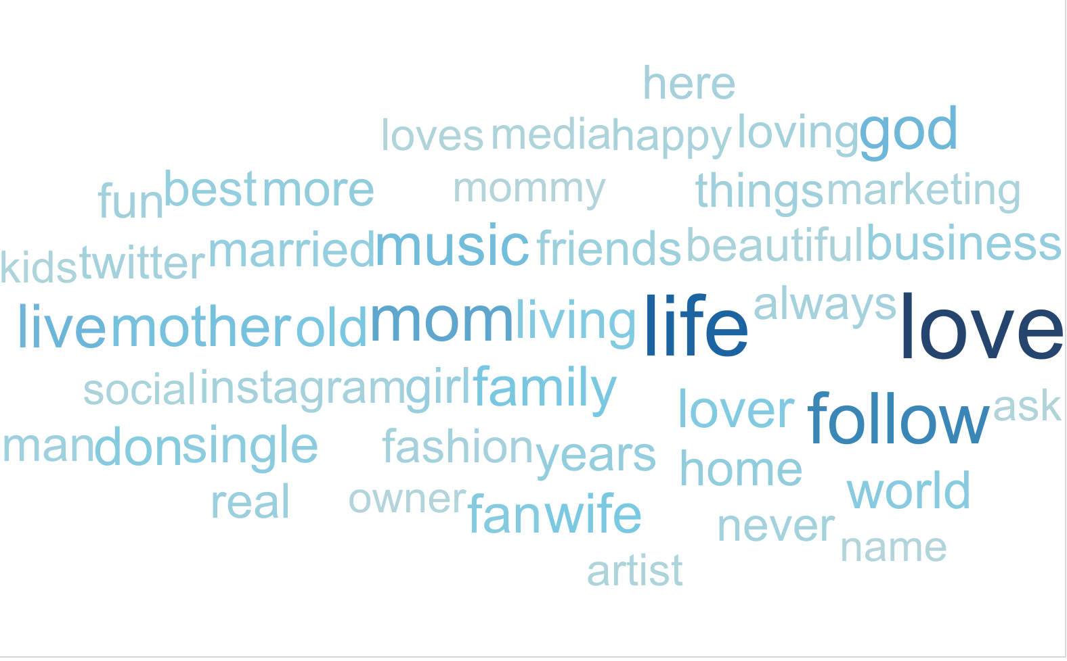
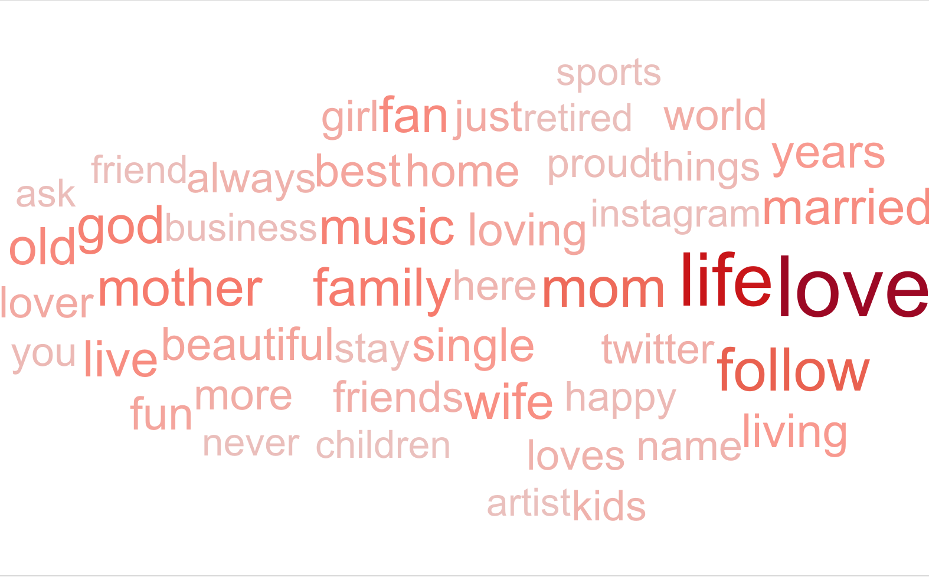
Sears and Kmart Single Word Word Cloud
Sears
Kmart

Slide 14
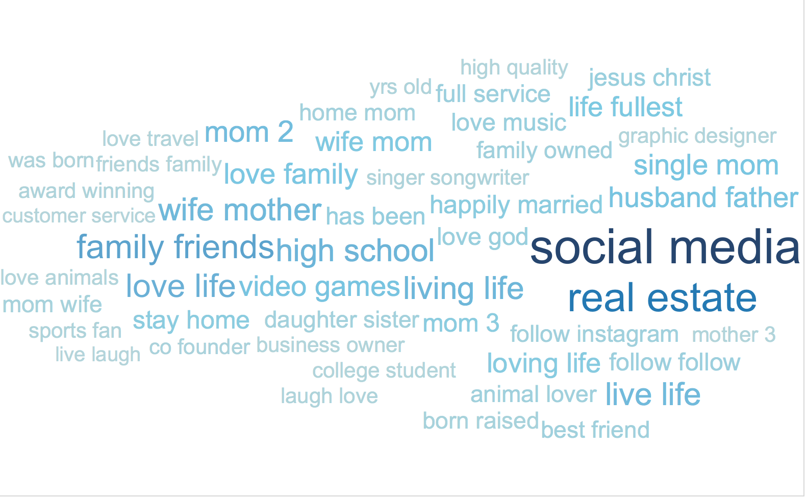
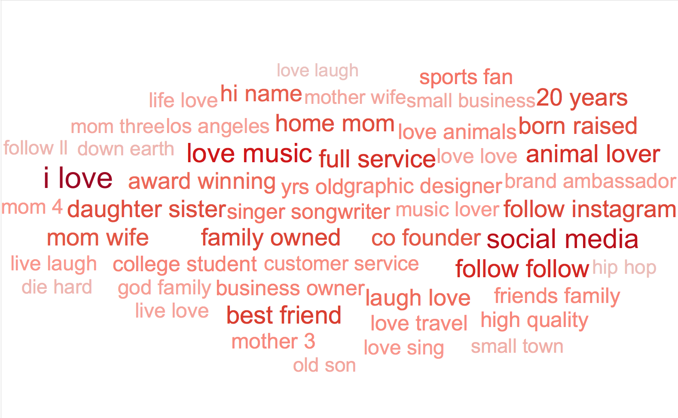
Sears and Kmart Double Word Word Cloud
Sears
Kmart

Slide 15
The gender distribution skews female, but this feature is more pronounced for Kmart
Sears
Kmart

Slide 16
Sears and Kmart trail JC Penney and Lowe’s on Facebook in the United States

Slide 17
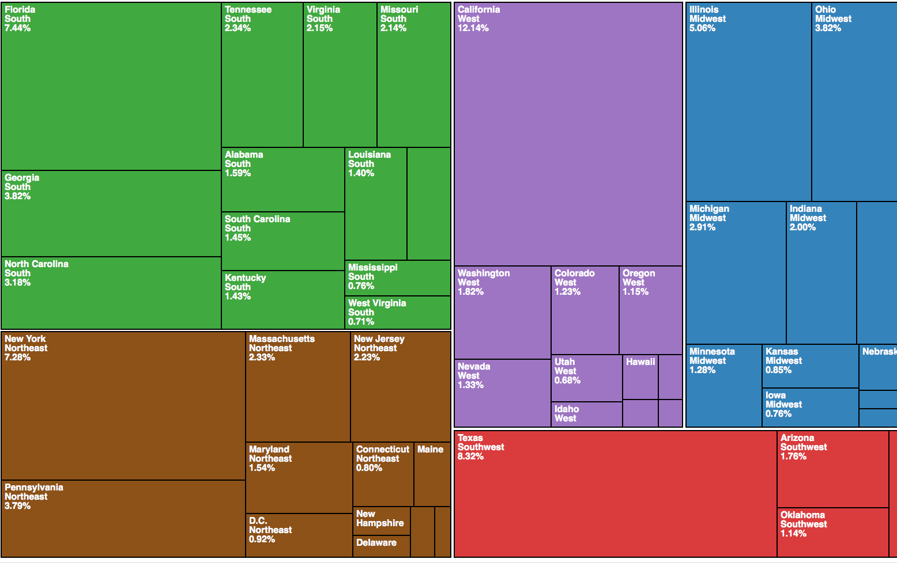
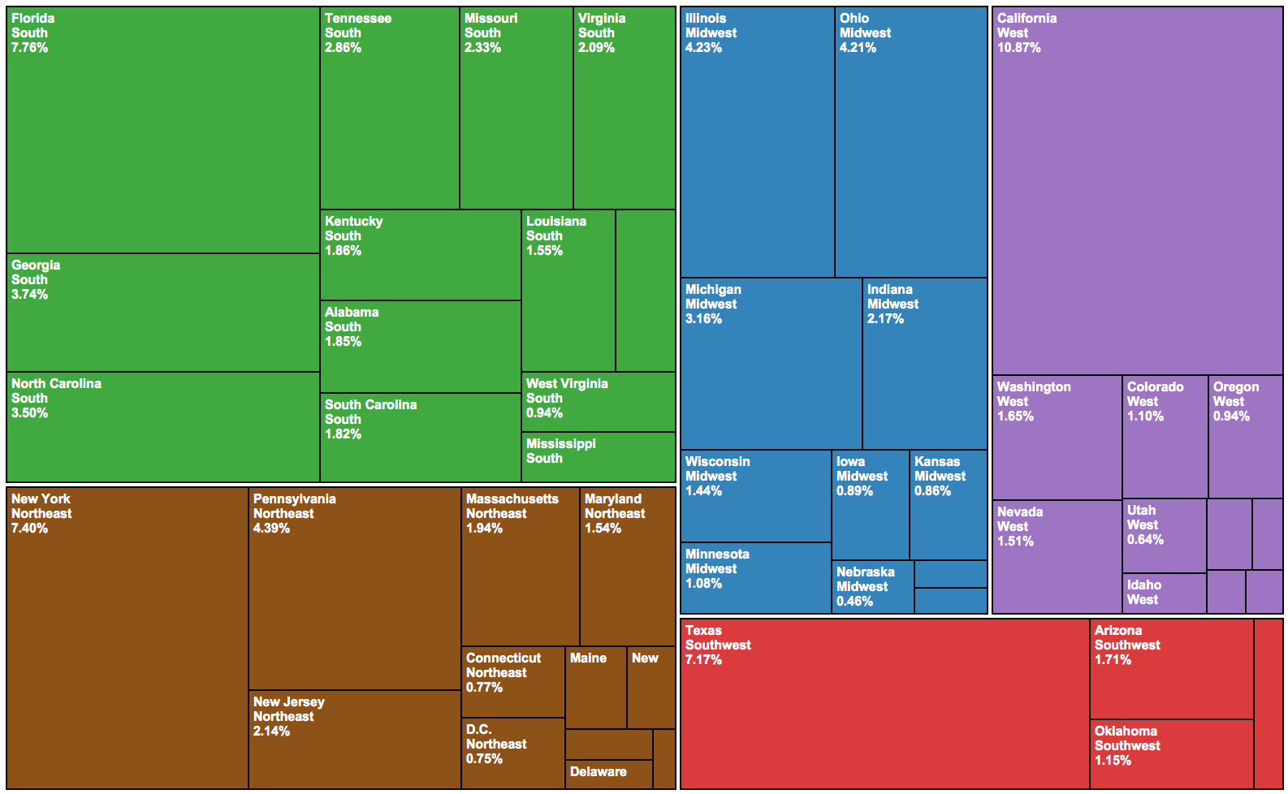
Sears and Kmart have similar spatial distributions of Twitter followers
Sears
Kmart

Slide 18
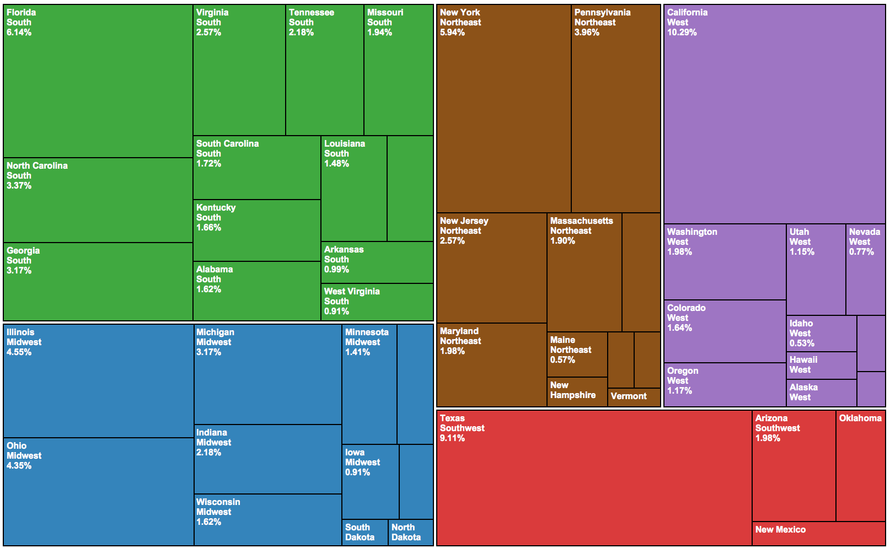
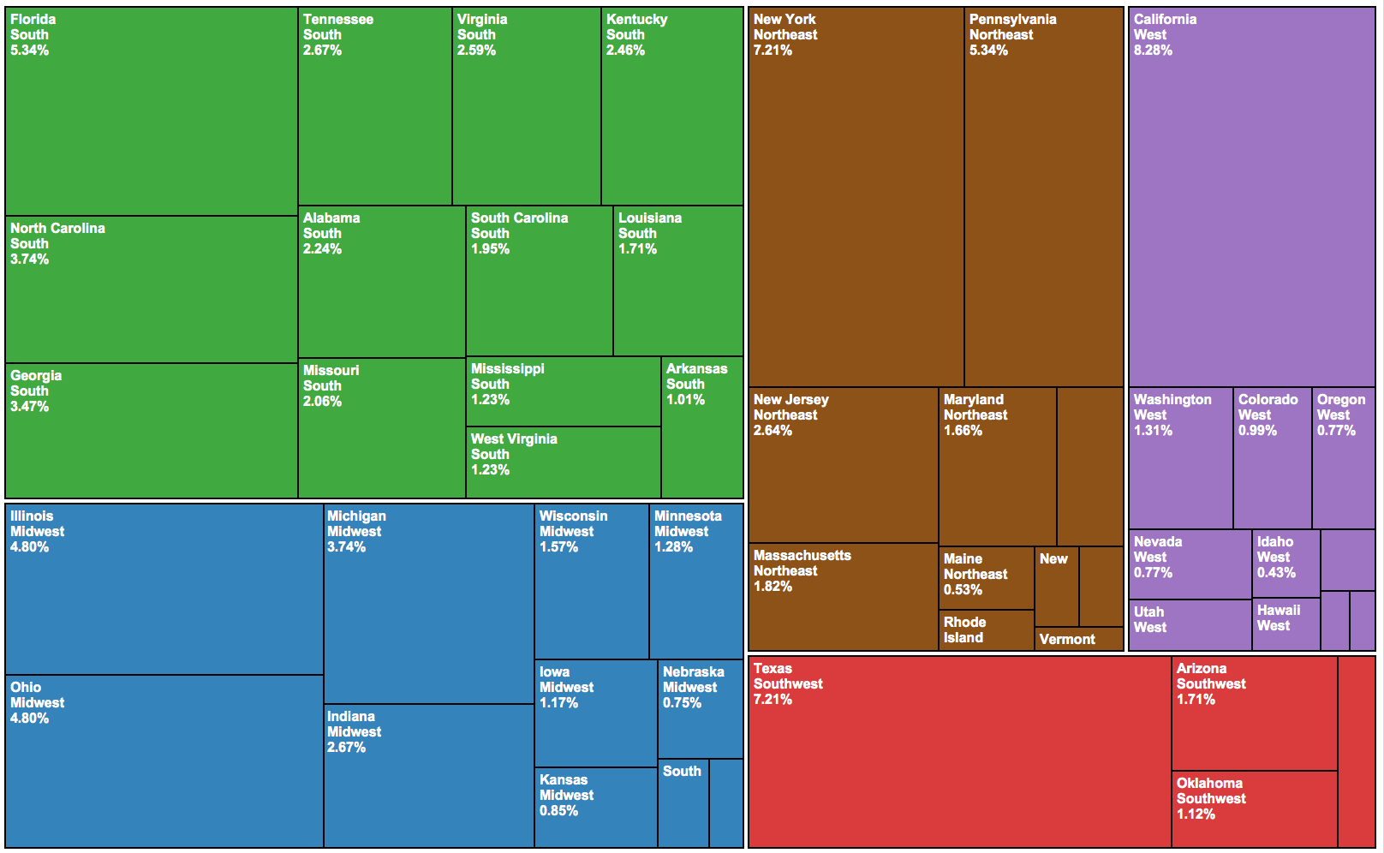
Sears and Kmart have similar spatial distributions of Facebook followers
Sears
Kmart

Slide 19
Comparing Social Media Density to Retail Store Density
By plotting the density of stores vs. audience, we can develop a strategic roadmap for audience development in four segments.
Markets with above average store density AND above average audience density are the base. Events and activations will be successful here.
Markets with above average store density BUT below average audience density are the targets for audience growth. We need to target competitor audiences here.
Markets with BELOW average store density and ABOVE average audience density are candidates for new stores. They’re also places where we should reward socially active/engaged consumers to keep them.
Markets with below average store density and below average audience density are lower priorities.

Slide 20
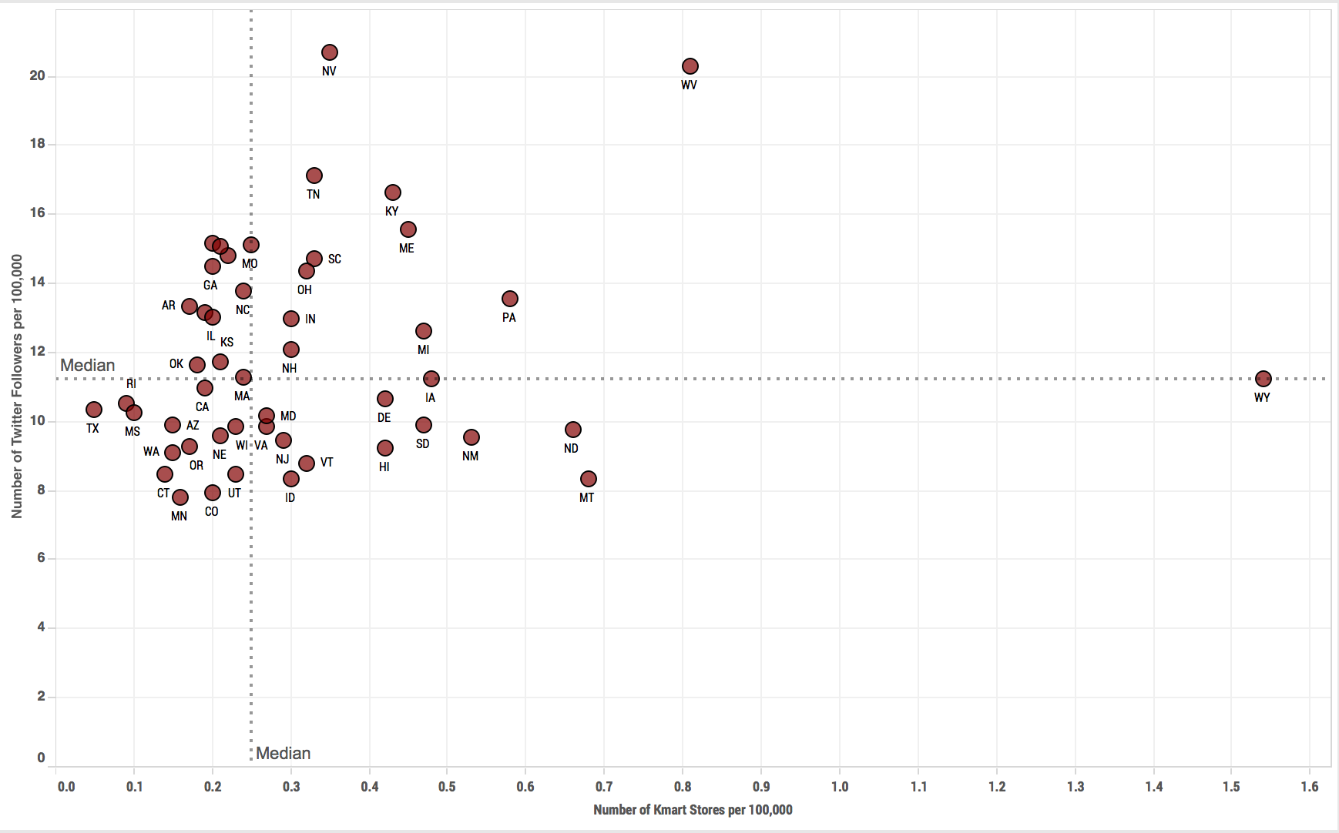
Comparison between the Geographical Distribution of Twitter Followers and of Kmart Stores in the United States

Slide 21
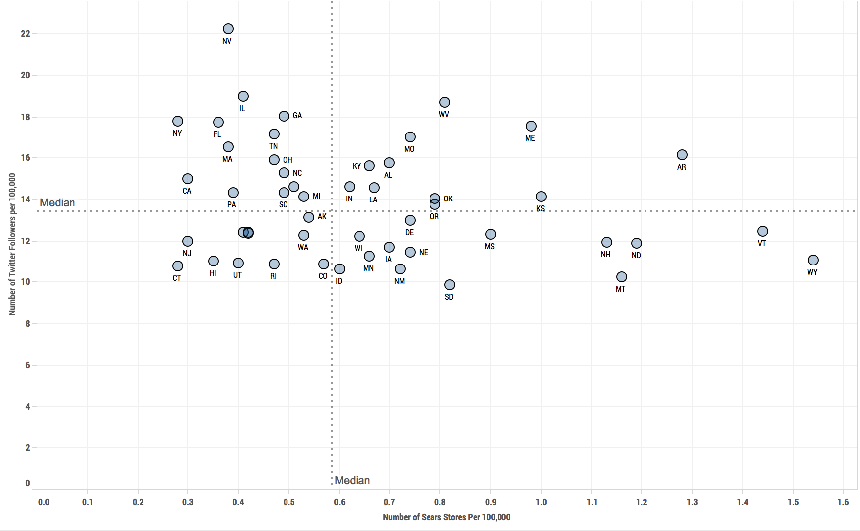
Comparison between the Geographical Distribution of Twitter Followers and of Sears Stores in the United States

Slide 22
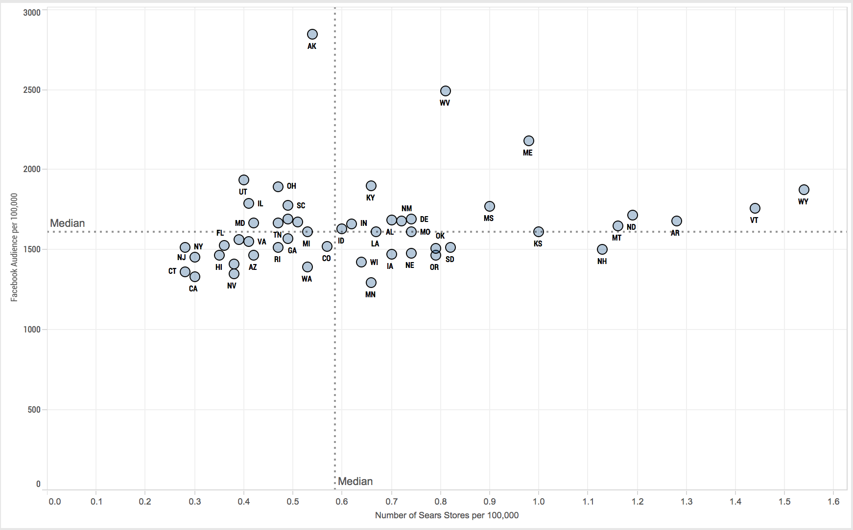
Comparison between the Geographical Distribution of Facebook Audience and of Sears Stores in the United States

Slide 23
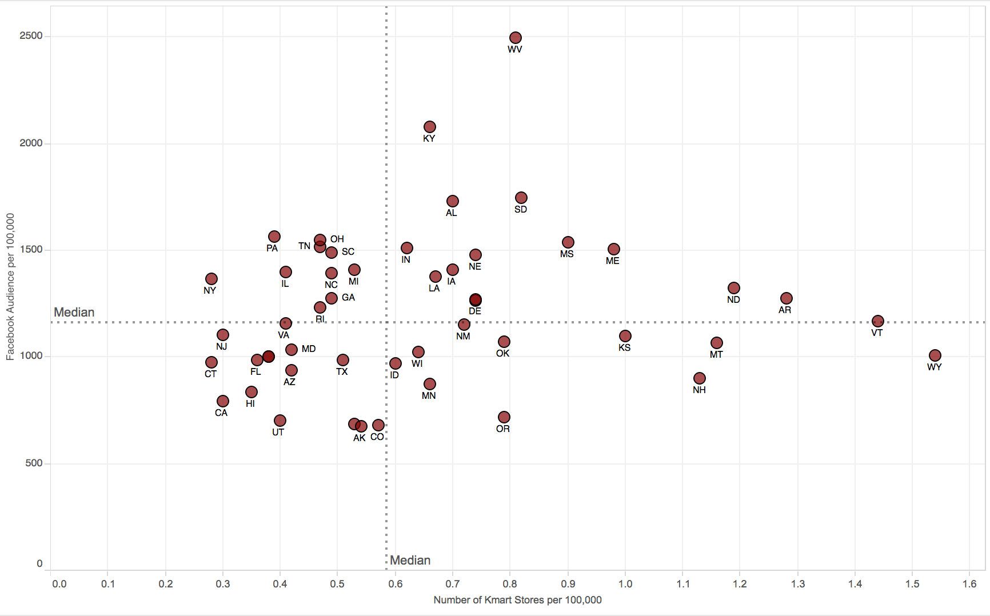
Comparison between the Geographical Distribution of Facebook Audience and of Kmart Stores in the United States

Slide 24
Twitter Influencers and Micro-influencers
Sears and K-Mart have a combined audience of almost ~6K followers who each have 20K+ followers of their own. We should treat this group like VIP’s, create custom audiences, and deliver special deals/offers/surveys etc., especially geared at incentivizing sharing.
Based on a sampling, 64% of these Sears influencers and 53% of K-Mart influencers are individual people and not companies. They’re especially valuable. (MOE +/- 8 with 95% confidence)

Slide 25
Distribution of Sears Followers by Social Influence: Absolute and Proportional Numbers

Slide 26
Distribution of Kmart Followers in the United States by Social Influence: Absolute and Proportional Numbers

Slide 27
Online Audience Demographic Comparison
Sears/K-Mart, JC Penny, and Lowe’s have very similar digital audience income breakdowns.
However, Sears/K-Mart trend younger than Lowe’s, while Lowe’s dominates the 35-49 age cohort. This suggests gearing efforts that compete with Lowe’s at Gen-X’ers.
All three groups have a racial breakdown that mirrors expected demographics given the age and income cohorts, with a heavier-than-expected weighting toward Latinos. Engaging Latino influencers and news outlets is advised.

Slide 28
Income Comparison of Sears and Kmart Combined Facebook Audience with Lowe’s Facebook Audience
Sears and Kmart Combined
Lowe’s

Slide 29
Income Comparison of Sears and Kmart Combined Facebook Audience with J.C. Penney Facebook Audience
Sears and Kmart Combined
J.C. Penney

Slide 30
Age Comparison of Sears and Kmart Combined Facebook Audience with Lowe’s Facebook Audience
Sears and Kmart Combined
Lowe’s

Slide 31
Age Comparison of Sears and Kmart Combined Facebook Audience with Lowe’s Facebook Audience
Sears and Kmart Combined
J.C. Penney

Slide 32
Ethnic Comparison of Sears and Kmart Combined Facebook Audience with J.C. Penney Facebook Audience
Sears and Kmart Combined
J.C. Penney

Slide 33
Ethnic Comparison of Sears and Kmart Combined Facebook Audience with Lowe’s Facebook Audience
Sears and Kmart Combined
Lowe’s

Slide 34
Analysis of Selected Audiences on Twitter: Lawn Care and Innovator-Entrepreneur-Execs
The lawn care audience is overwhelmingly female and has lower levels of social activity. Grass roots (no pun intended) engagement will be key to reaching them.
Same goes for the innovator audience, only they’re heavily male.
Lowe’s currently dominates both these audiences online. This suggests a “peer social media acquisition” strategy where Sears strategically follows and communicates with this micro-target group… over time bringing them closer and developing better connectivity.

Slide 35
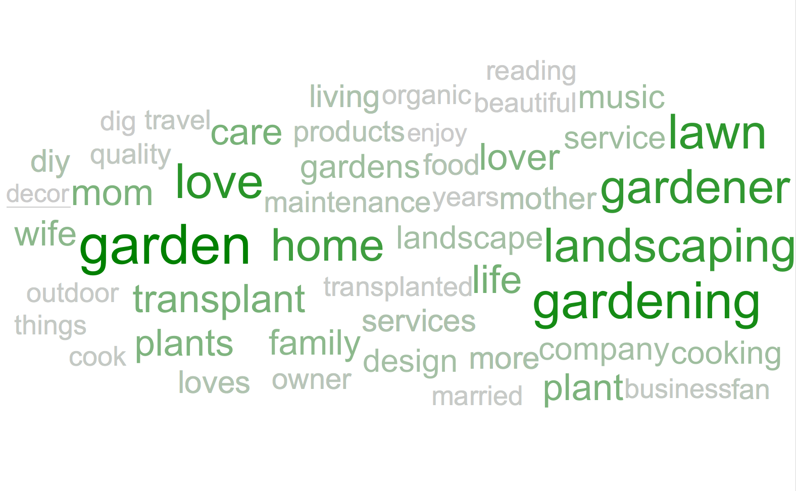
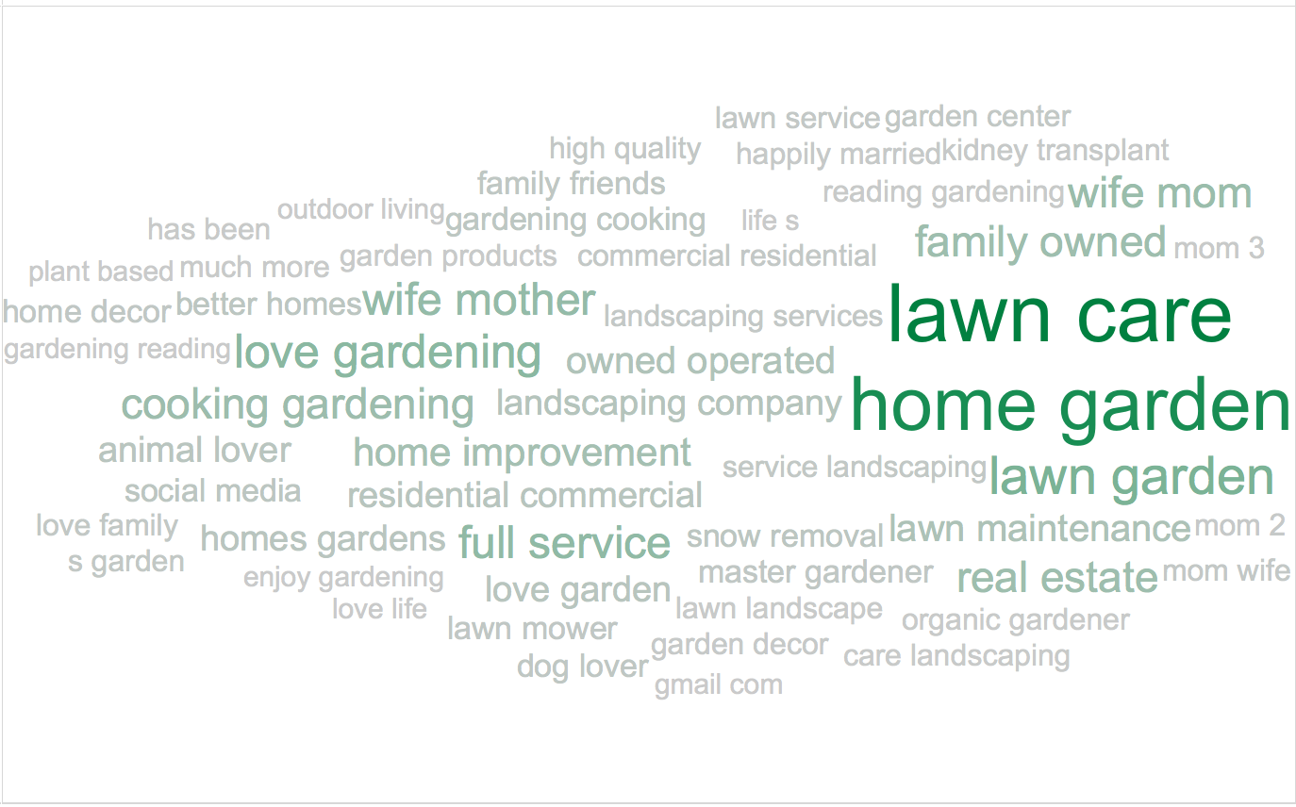
Twitter followers interested in gardening and lawn-care
Through keyword search we identified 3,972 twitter users with keywords related to gardening or lawn-care within major retailers twitter audiences.
Of these 3,972, 2,808 (70.69%) had enough data to locate them as living in one of the 50 states or DC.
The word clouds to the left provides samples of common terms, keywords, and expressions within these users twitter bios.
The leftmost one is a single word cloud, while the rightmost is a bi-gram word cloud

Slide 36
Gardening and lawn-care audiences is overwhelmingly female and is not particularly active on Twitter
Gender
Levels of Twitter Engagement

Slide 37
Distribution of gardening and lawn-care audience in the United States by social influence: Absolute and Proportional Numbers

Slide 38
Most garden and lawn-care audiences follow exclusively Lowe’s on Twitter

Slide 39
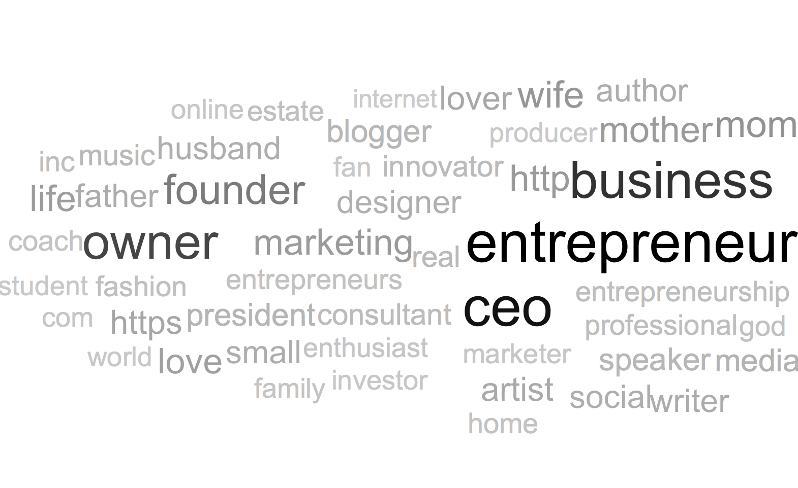
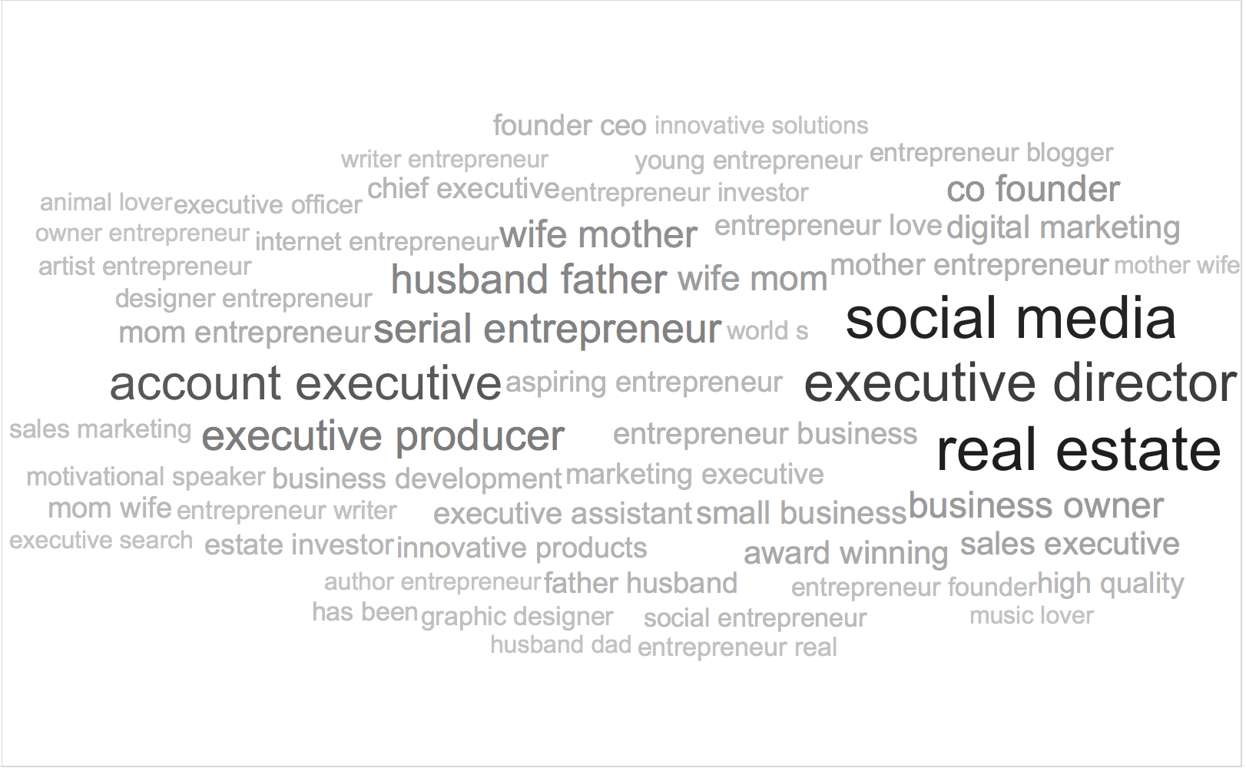
Twitter Executives, Innovators, and Entrepreneurs
Through keyword search we identified 6,210 twitter users within major retailers twitter audiences that had keywords that identified them as executives, innovators, or entrepreneurs
Of these, 4,345 (69.96%) had enough data to locate them as living in one of the 50 states or DC.
The leftmost one is a single word cloud, while the rightmost is a bi-gram word cloud
The leftmost one is a single word word cloud, while the rightmost is a bi gram word cloud

Slide 40
Innovators are slightly more likely to be male and is also not particularly active on Twitter
Gender
Levels of Twitter Engagement

Slide 41
Distribution of innovators in the United States by social influence: Absolute and Proportional Numbers

Slide 42
Most Innovators follow exclusively Lowe’s on Twitter

